Slide 1
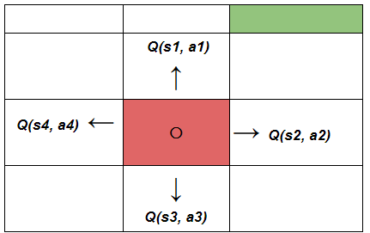
L7.2 Value-based RL
Zonghua Gu 2022
Acknowledgement: slides based on https://www.coursera.org/specializations/reinforcement-learning
And textbook by Sutton and Barto http://incompleteideas.net/book/the-book-2nd.html
Notes:
https://blog.floydhub.com/an-introduction-to-q-learning-reinforcement-learning/

Slide 2
Outline
Introduction
Markov Decision Process (MDP)
Monte Carlo Methods
TD-Learning
Sarsa & Q-Learning
Function Approximation

Slide 3
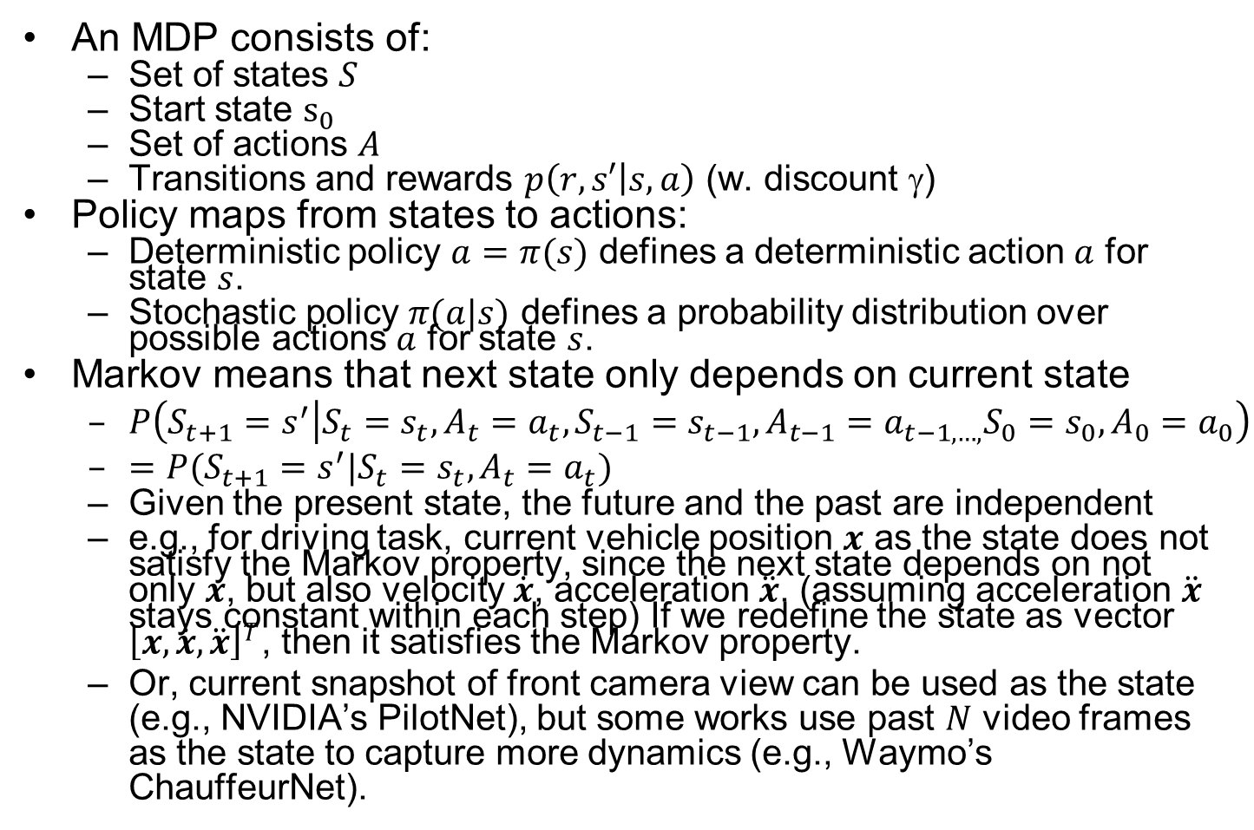
Markov Decision Process (MDP)
An MDP consists of:
Set of states $S$
Start state $s_{0}$
Set of actions $A$
Transitions and rewards $p\left(r,s′ | s,a\right)$ (w. discount $$)
Policy maps from states to actions:
Deterministic policy $a=π(s)$ defines a deterministic action $a$ for state $s$.
Stochastic policy $π(a|s)$ defines a probability distribution over possible actions $a$ for state $s$.
Markov means that next state only depends on current state
$P\left(S_{t+1}=s^{′} | S_{t}=s_{t},A_{t}=a_{t},S_{t−1}=s_{t−1},A_{t−1}=a_{t−1,…,}S_{0}=s_{0},A_{0}=a_{0}\right)$
$=P(S_{t+1}=s^{′}|S_{t}=s_{t},A_{t}=a_{t})$
Given the present state, the future and the past are independent
e.g., for driving task, current vehicle position $x$ as the state does not satisfy the Markov property, since the next state depends on not only $x$, but also velocity $\dot{x}$, acceleration $\ddot{x}$. (assuming acceleration $\ddot{x}$ stays constant within each step) If we redefine the state as vector ${\left[x,\dot{x}, \ddot{x}\right]}^{T}$, then it satisfies the Markov property.
Or, current snapshot of front camera view can be used as the state (e.g., NVIDIA’s PilotNet), but some works use past $N$ video frames as the state to capture more dynamics (e.g., Waymo’s ChauffeurNet).
Notes:
Add utility slide, (like policy) Utility (Cumulative Reward) measured by Value function $V(s)$: sum of cumulative (discounted) rewards (utility) starting from state $s$ TODO 2 versions, optimal or policy
Q Value function $Q(s,a)$: sum of cumulative (discounted) rewards (utility) starting from state $s$ and taking action $a$.
v

Slide 4
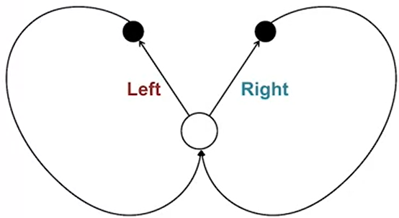
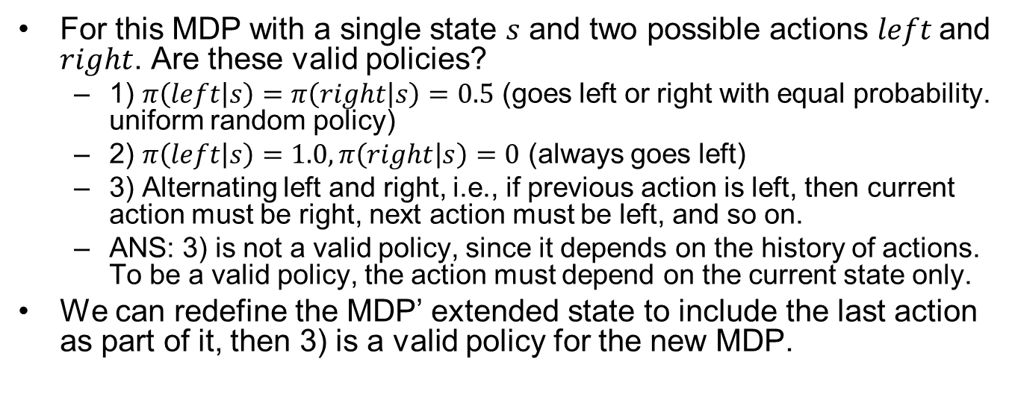
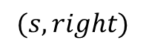
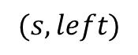
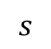
MDP Quiz
For this MDP with a single state $s$ and two possible actions $left$ and $right$. Are these valid policies?
1) $π\left(left | s\right)=π\left(right | s\right)=0.5$ (goes left or right with equal probability. uniform random policy)
2) $π\left(left | s\right)=1.0,π\left(right | s\right)=0$ (always goes left)
3) Alternating left and right, i.e., if previous action is left, then current action must be right, next action must be left, and so on.
ANS: 3) is not a valid policy, since it depends on the history of actions. To be a valid policy, the action must depend on the current state only.
We can redefine the MDP’ extended state to include the last action as part of it, then 3) is a valid policy for the new MDP.
$$(s, left)$$
$$(s, right)$$
$$s$$

Slide 5
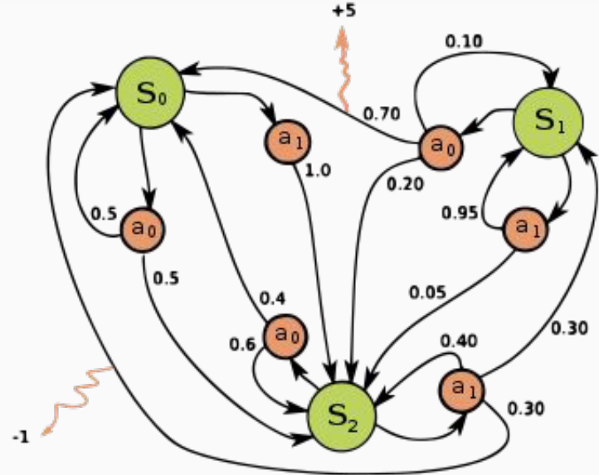
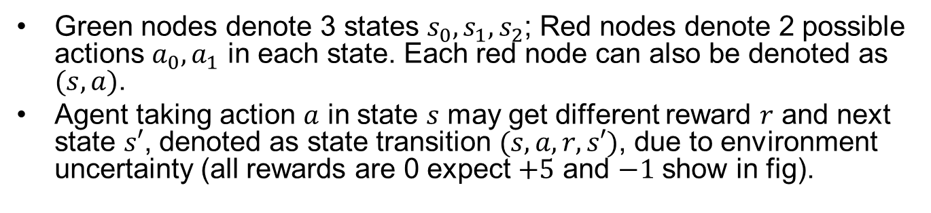
An Example MDP
Green nodes denote 3 states $s_{0},s_{1},s_{2}$; Red nodes denote 2 possible actions ${a_{0},a}_{1}$ in each state. Each red node can also be denoted as $(s,a)$.
Agent taking action $a$ in state $s$ may get different reward $r$ and next state $s′$, denoted as state transition $(s,a,r,s′)$, due to environment uncertainty (all rewards are 0 expect $+5$ and $−1$ show in fig).
Notes:
State transition $(s,a,r,s′)$ is atomic.

Slide 6
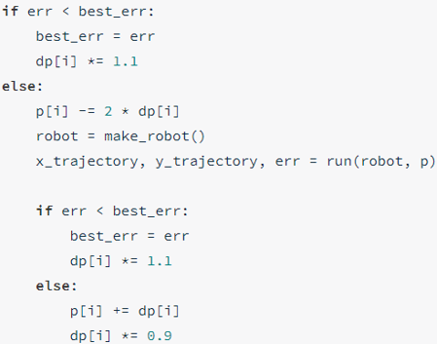
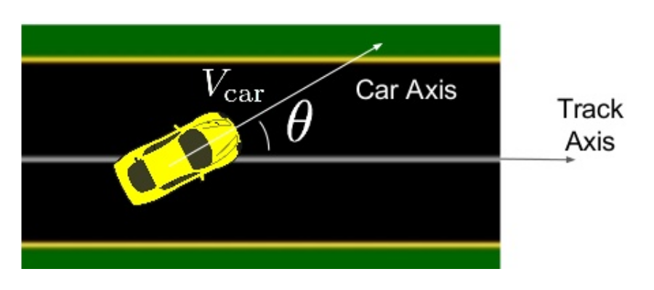
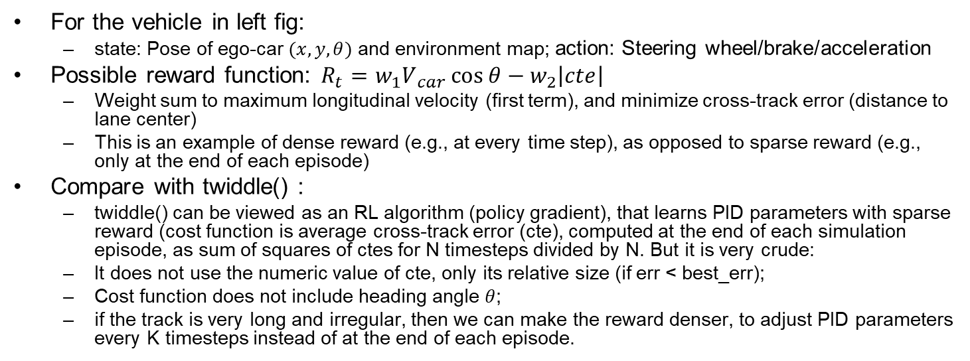
RL Reward Function
For the vehicle in left fig:
state: Pose of ego-car $(x,y,θ)$ and environment map; action: Steering wheel/brake/acceleration
Possible reward function: $R_{t}​=w_{1}V​_{car}\cos{θ}−​w_{2}\left|cte\right|​$
Weight sum to maximum longitudinal velocity (first term), and minimize cross-track error (distance to lane center)
This is an example of dense reward (e.g., at every time step), as opposed to sparse reward (e.g., only at the end of each episode)
Compare with twiddle() :
twiddle() can be viewed as an RL algorithm (policy gradient), that learns PID parameters with sparse reward (cost function is average cross-track error (cte), computed at the end of each simulation episode, as sum of squares of ctes for N timesteps divided by N. But it is very crude:
It does not use the numeric value of cte, only its relative size (if err < best_err);
Cost function does not include heading angle $θ$;
if the track is very long and irregular, then we can make the reward denser, to adjust PID parameters every K timesteps instead of at the end of each episode.
twiddle()
Ben Lau, Quantitative Researcher, Hobbyist, at MLconf NYC 2017
Notes:
PID controller is used to track a fixed circular path
Intuitive reward function: $R_{t}=V_{car}\cos{θ}$
maximum longitudinal velocity
Sometimes need to do “reward function hacking” to find one that works well, e.g., $R_{t}​=V​_{car}\cos{θ}−V_{car}​​​sin⁡θ−V​_{car}​\left|cte\right|​$
$$V_{car}​​​sin⁡θ$$

Slide 7

Amazon DeepRacer
Amazon Web Services (AWS) launched DeepRacer in 2018 for training AD algorithms with RL
https://aws.amazon.com/deepracer/
You can train RL algorithm in the simulator on AWS cloud, but it costs money after some free time.
They hold competitions, both online and in real-world. 1/10th scale race car costs USD $349.

Slide 8
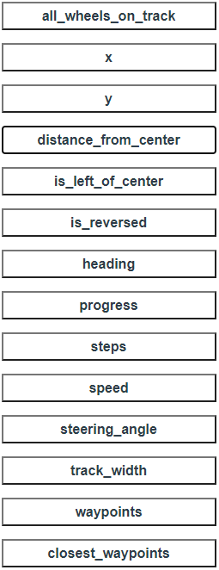
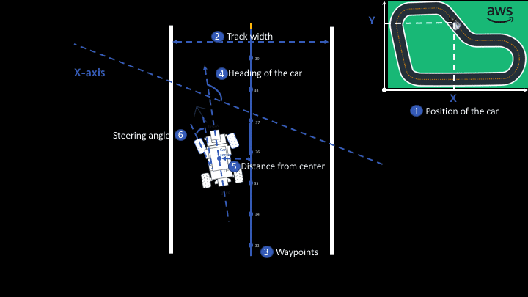
Params for Writing Reward Function
Notes:
Writing a Reward Function

Slide 9
Example Reward Function
def reward_function(params):
'''Example of penalize steering, which helps mitigate zig-zag behaviors'''
# Read input parameters
distance_from_center = params['distance_from_center']
track_width = params['track_width']
steering = abs(params['steering_angle']) # Only need the absolute steering angle
# Calculate 3 markers that are at varying distances away from the center line
marker_1 = 0.1 * track_width
marker_2 = 0.25 * track_width
marker_3 = 0.5 * track_width
# Give higher reward if the agent is closer to center line and vice versa
if distance_from_center <= marker_1:
reward = 1
elif distance_from_center <= marker_2:
reward = 0.5
elif distance_from_center <= marker_3:
reward = 0.1
else:
reward = 1e-3 # likely crashed/ close to off track
# Steering penalty threshold, change the number based on your action space setting
ABS_STEERING_THRESHOLD = 15
# Penalize reward if the agent is steering too much
if steering > ABS_STEERING_THRESHOLD:
reward *= 0.8
return float(reward)
A more realistic and complex reward function: https://www.middleware-solutions.fr/2019/08/14/an-introduction-to-aws-deepracer

Slide 10



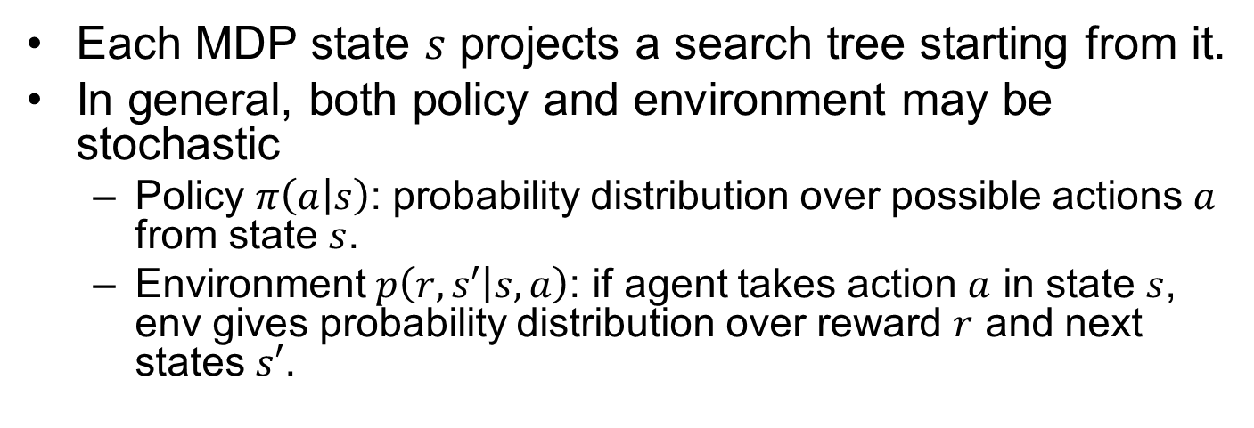
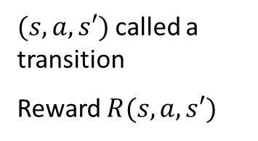
MDP Search Tree
Each MDP state $s$ projects a search tree starting from it.
In general, both policy and environment may be stochastic
Policy $π\left(a | s\right)$: probability distribution over possible actions $a$ from state $s$.
Environment $p\left(r,s′ | s,a\right)$: if agent takes action $a$ in state $s$, env gives probability distribution over reward $r$ and next states $s′$.
s
s is a state
a
(s, a) is a q-state
s, a
$(s,a,s′)$ called a transition
Reward $R(s,a,s′)$
s,a,s’
s’
Notes:
In MDP chance node represents uncertainty about what might happen based on (s,a) [as opposed to being a random adversary]
$$T(s,a,s’)$$
Q-state (s,a) is when you were in a state and took an action
Best average, long term reward
Expectimax, but no real terminal node.
Does not have min-nodes
State node vs q state nodes

Slide 11
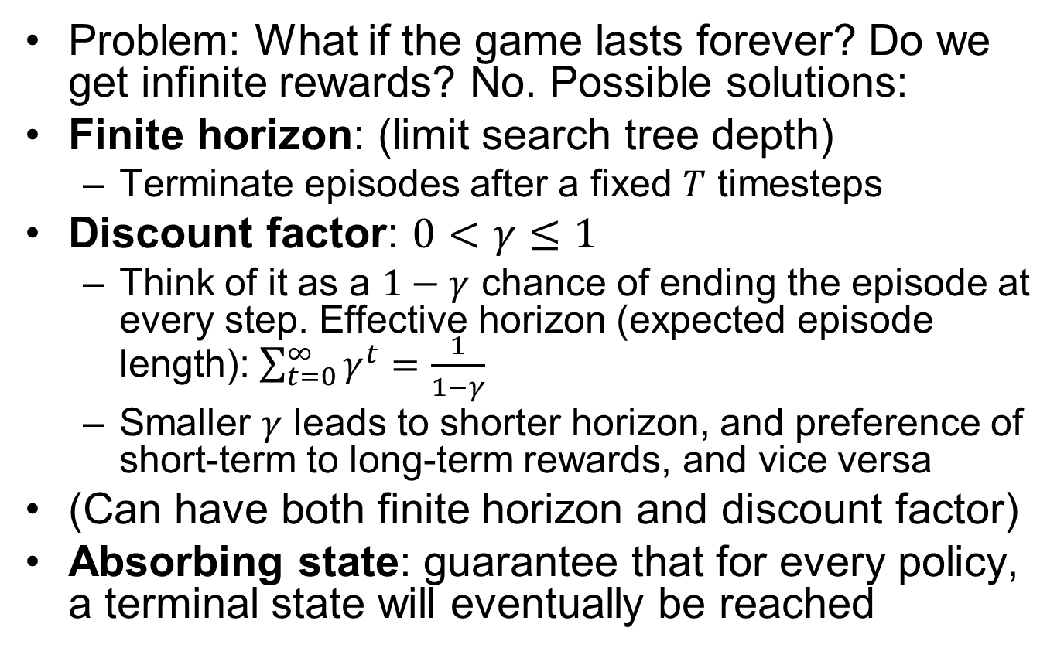
Preventing Infinite Rewards
Problem: What if the game lasts forever? Do we get infinite rewards? No. Possible solutions:
Finite horizon: (limit search tree depth)
Terminate episodes after a fixed $T$ timesteps
Discount factor: $0<γ≤1$
Think of it as a $1−γ$ chance of ending the episode at every step. Effective horizon (expected episode length): $\sum_{t=0}^{∞}{γ^{t}}=\frac{1}{1−γ}$
Smaller $γ$ leads to shorter horizon, and preference of short-term to long-term rewards, and vice versa
(Can have both finite horizon and discount factor)
Absorbing state: guarantee that for every policy, a terminal state will eventually be reached
Notes:
$$U\left(\left[r_{0},…,r_{∞}\right]\right)=\sum_{t=0}^{∞}{γ^{t}r_{t}}≤\sum_{t=0}^{∞}{γ^{t}r_{max}}=\frac{r_{max}}{1−γ}$$

Slide 12





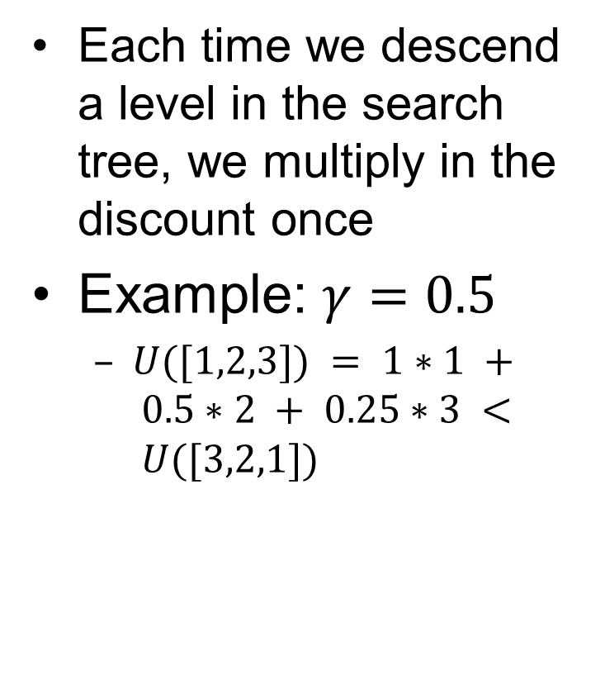
Discount Factor Example
Each time we descend a level in the search tree, we multiply in the discount once
Example: $γ=0.5$
$U([1,2,3]) = 1∗1 + 0.5∗2 + 0.25∗3 < U([3,2,1])$
Notes:
Rewards in the future (deeper in the tree) matter less
Interesting: running expectimax, if having to truncate the search, then not losing much; e.g., less then \gamma^d / (1-\gamma)
Augment q states with another option: instant death!
Repeated loop, difference from search, is a win. Distinction of visiting a state.
Do the example.

Slide 13

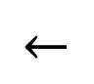
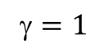
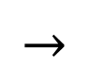
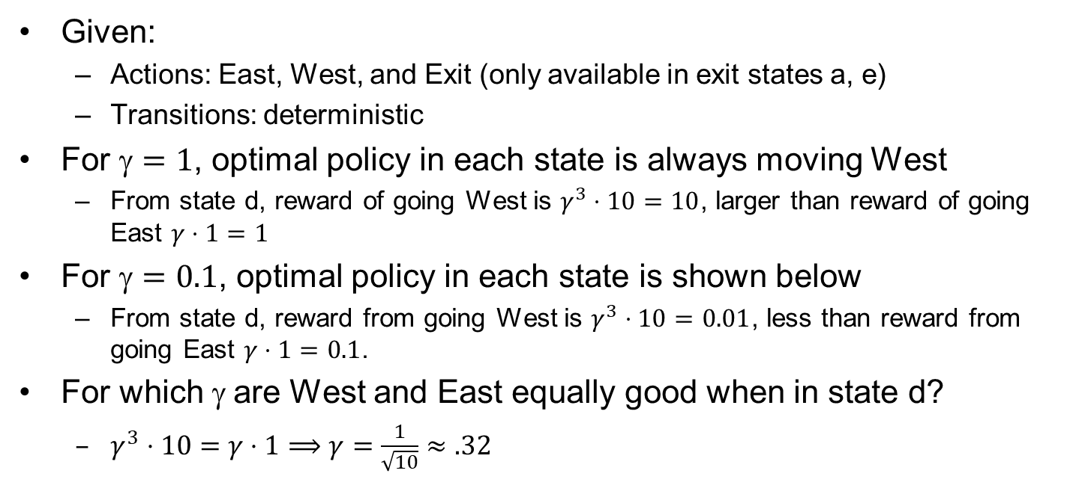
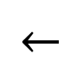
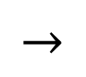
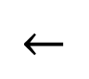
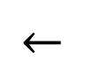
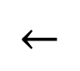
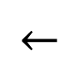
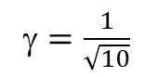
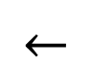
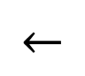
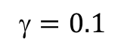
Discounting Example
Given:
Actions: East, West, and Exit (only available in exit states a, e)
Transitions: deterministic
For $=1$, optimal policy in each state is always moving West
From state d, reward of going West is $γ^{3}⋅10=10$, larger than reward of going East $γ⋅1=1$
For $=0.1$, optimal policy in each state is shown below
From state d, reward from going West is $γ^{3}⋅10=0.01$, less than reward from going East $γ⋅1=0.1$.
For which $$ are West and East equally good when in state d?
$γ^{3}⋅10=γ⋅1⟹γ=\frac{1}{\sqrt{10}}≈.32$
$$←$$
$$←$$
$$←$$
$$←$$
$$←$$
$$→$$
$$←$$
$$←$$
$$←$$
$$→$$
$=1$
$=0.1$
$=\frac{1}{\sqrt{10}}$

Slide 14
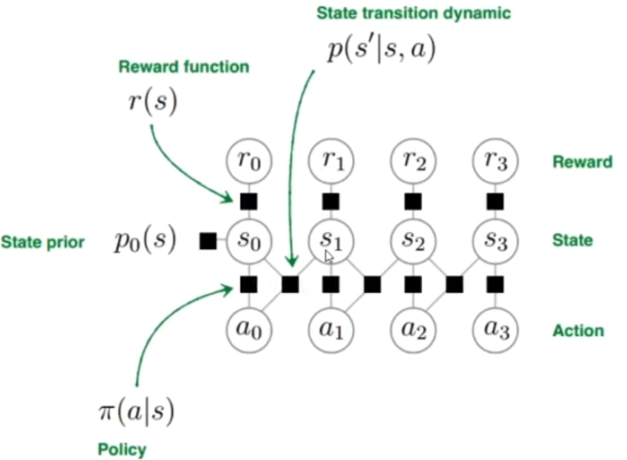
Known MDP
In this lecture, we assume known MDP, and use dynamic programming to solve Bellman Equations and find the optimal policy (no learning here).
known
known
want to optimize
Notes:
https://www.bilibili.com/video/BV1hg4y1873j?from=search&seid=14821159815301028409

Slide 15
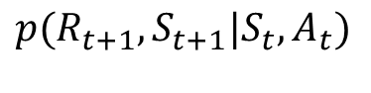
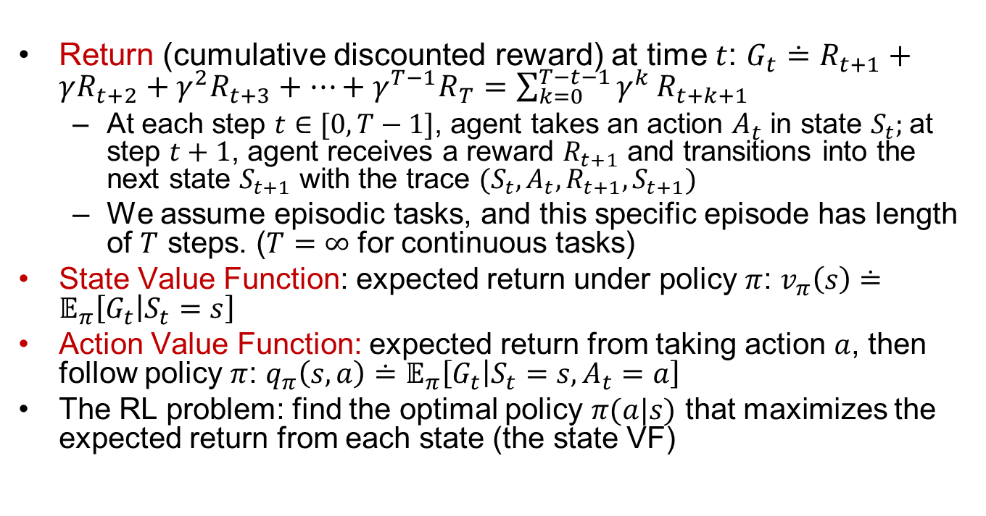

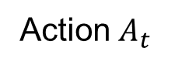
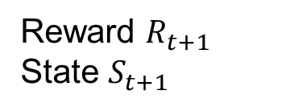
Formal Definition of MDP
Important
Return (cumulative discounted reward) at time $t$: $G_{t}≐R_{t+1}+γR_{t+2}+γ^{2}R_{t+3}+…+γ^{T−1}R_{T}=\sum_{k=0}^{T−t−1}{γ^{k}}R_{t+k+1}$
At each step $t∈[0,T−1]$, agent takes an action $A_{t}$ in state $S_{t}$; at step $t+1$, agent receives a reward $R_{t+1}$ and transitions into the next state $S_{t+1}$ with the trace $(S_{t}, A_{t}, R_{t+1}, S_{t+1})$
We assume episodic tasks, and this specific episode has length of $T$ steps. ($T=∞$ for continuous tasks)
State Value Function: expected return under policy $π$: $v_{π}\left(s\right)≐𝔼_{π}\left[G_{t} | S_{t}=s\right]$
Action Value Function: expected return from taking action $a$, then follow policy $π$: $q_{π}\left(s,a\right)≐𝔼_{π}\left[G_{t} | S_{t}=s,A_{t}=a\right]$
The RL problem: find the optimal policy $π(a|s)$ that maximizes the expected return from each state (the state VF)
$${p(R_{t+1}, S}_{t+1}|S_{t},A_{t})$$
Environment
Action $A_{t}$
Reward $R_{t+1}$
State $S_{t+1}$
RL Agent
$$π(A_{t}|S_{t})$$

Slide 16
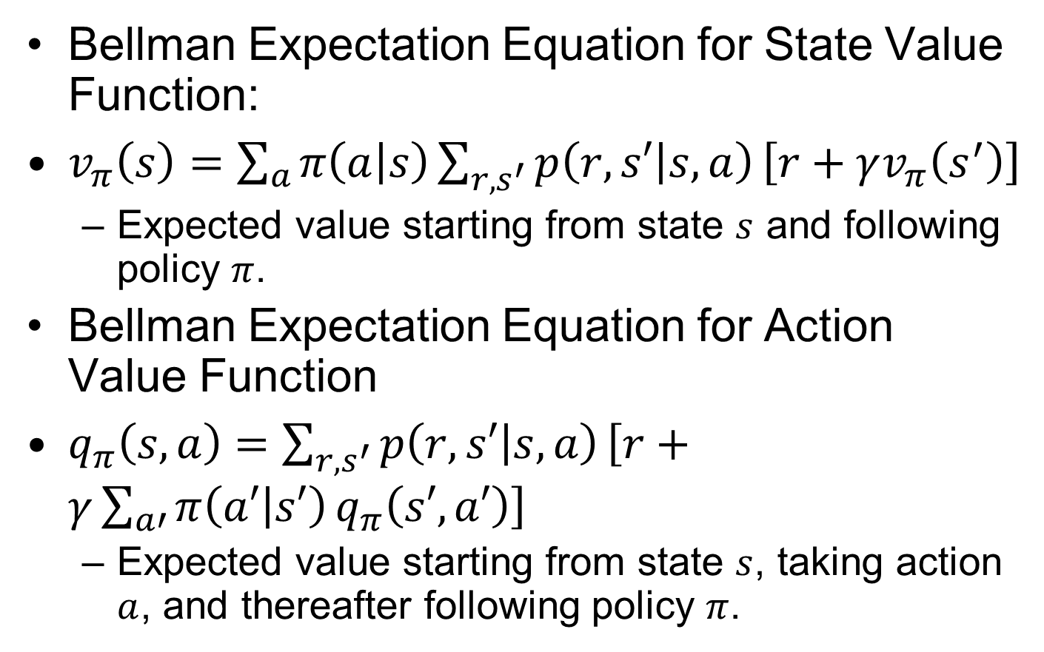
Bellman Expectation Equations
Important
Bellman Expectation Equation for State Value Function:
$v_{π}\left(s\right)=\sum_{a}{π\left(a | s\right)}\sum_{r,s^{′}}{p\left(r,s′ | s,a\right)}\left[r+γv_{π}\left(s^{′}\right)\right]$
Expected value starting from state $s$ and following policy $π$.
Bellman Expectation Equation for Action Value Function
$q_{π}\left(s,a\right)=\sum_{r,s^{′}}{p\left(r,s′ | s,a\right)}\left[r+γ\sum_{a′}{π\left(a′ | s′\right)}q_{π}\left(s′,a′\right)\right]$
Expected value starting from state $s$, taking action $a$, and thereafter following policy $π$.
Notes:
$=𝔼_{π}[R_{t+1}+γv_{π}(S_{t+1})|S_{t}=s]$ $=𝔼_{π}[R_{t+1}+γv_{π}(S_{t+1})|S_{t}=s, A_{t}=a]$

Slide 17
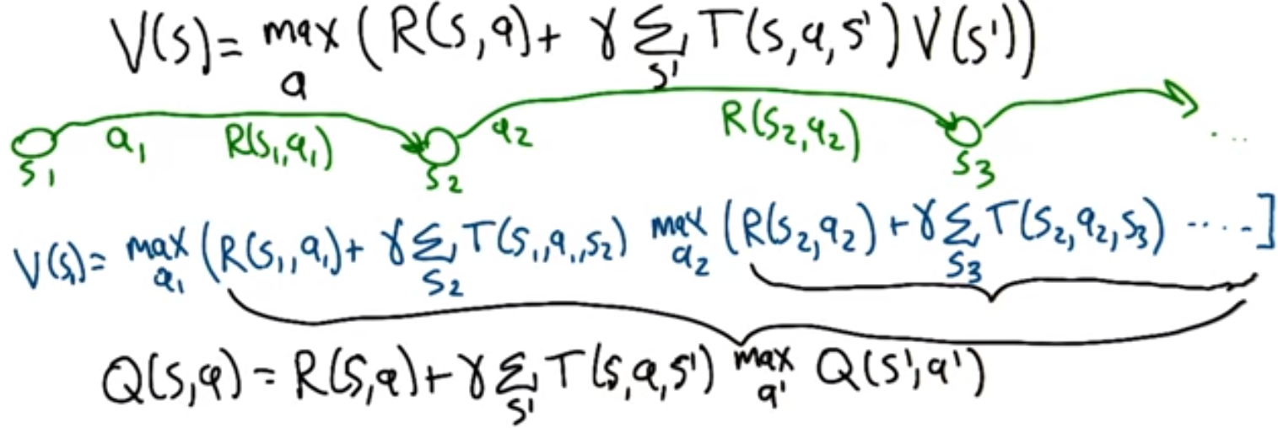
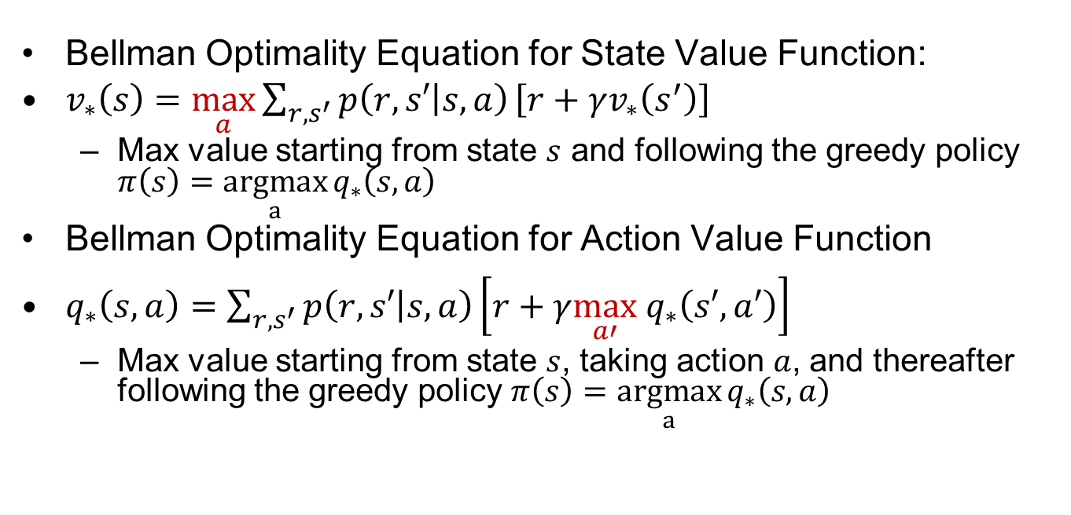
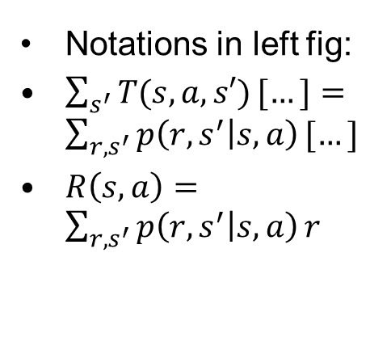
Bellman Optimality Equations
Important
Bellman Optimality Equation for State Value Function:
$v_{∗}\left(s\right)=$ $\max_{a}{\sum_{r,s^{′}}{p\left(r,s′ | s,a\right)}\left[r+γv_{∗}\left(s^{′}\right)\right]}$
Max value starting from state $s$ and following the greedy policy $π\left(s\right)=$ $\underset{a}{argmax}{q_{∗}\left(s,a\right)}$
Bellman Optimality Equation for Action Value Function
$q_{∗}\left(s,a\right)=\sum_{r,s^{′}}{p\left(r,s′ | s,a\right)}\left[r+γ\max_{a′} q_{∗}\left(s′,a′\right)\right]$
Max value starting from state $s$, taking action $a$, and thereafter following the greedy policy $π\left(s\right)=$ $\underset{a}{argmax}{q_{∗}\left(s,a\right)}$
Notations in left fig:
$\sum_{s^{′}}{T(s,a,s′)}[…]=\sum_{r,s^{′}}{p\left(r,s^{′} | s,a\right)}[…]$
$R\left(s,a\right)=\sum_{r,s^{′}}{p\left(r,s^{′} | s,a\right)}r$
Notes:
$$v_{∗}\left(s\right)=\max_{a} q_{∗}\left(s,a\right);q_{∗}\left(s,a\right)=\sum_{r,s^{′}}{p\left(r,s′ | s,a\right)}\left[r+γv_{∗}\left(s′\right)\right]$$
$$q_{∗}\left(C,l\right)=\sum_{r,s^{′}}{p\left(r,s′ | s,a\right)}\left[r+γv_{∗}\left(s′\right)\right]$$

Slide 18
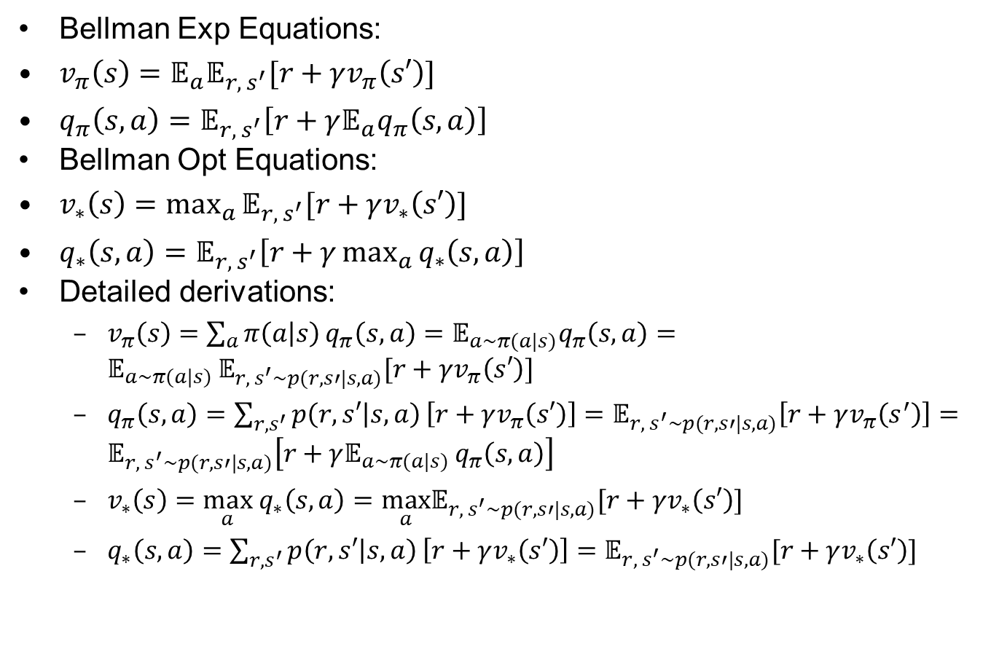
Bellman Equations written with Expectation Symbols
Bellman Exp Equations:
$v_{π}\left(s\right)=𝔼_{a}𝔼_{r, s^{′}}[r+γv_{π}\left(s′\right)]$
$q_{π}\left(s,a\right)=𝔼_{r, s^{′}}\left[r+γ𝔼_{a}q_{π}\left(s,a\right)\right]$
Bellman Opt Equations:
$v_{∗}\left(s\right)=\max_{a}{𝔼_{r, s^{′}}[r+γv_{∗}\left(s′\right)]}$
$q_{∗}\left(s,a\right)=𝔼_{r, s^{′}}\left[r+γ\max_{a}{q_{∗}\left(s,a\right)}\right]$
Detailed derivations:
$v_{π}\left(s\right)=\sum_{a}{π\left(a | s\right)}q_{π}\left(s,a\right)=𝔼_{a∼π(a|s)}q_{π}\left(s,a\right)=𝔼_{a∼π(a|s) }𝔼_{r, s^{′}∼p(r,s′|s,a)}[r+γv_{π}\left(s′\right)]$
$q_{π}\left(s,a\right)=\sum_{r,s^{′}}{p\left(r,s′ | s,a\right)}\left[r+γv_{π}\left(s′\right)\right]=𝔼_{r, s^{′}∼p(r,s′|s,a)}\left[r+γv_{π}\left(s^{′}\right)\right]=𝔼_{r, s^{′}∼p(r,s′|s,a)}\left[r+γ𝔼_{a∼π(a|s) }q_{π}\left(s,a\right)\right]$
$v_{∗}\left(s\right)=\max_{a} q_{∗}\left(s,a\right)=\max_{a}𝔼_{r, s^{′}∼p(r,s′|s,a)}[r+γv_{∗}\left(s′\right)]$
$q_{∗}\left(s,a\right)=\sum_{r,s^{′}}{p\left(r,s′ | s,a\right)}\left[r+γv_{∗}\left(s′\right)\right]=𝔼_{r, s^{′}∼p(r,s′|s,a)}[r+γv_{∗}\left(s′\right)]$

Slide 19
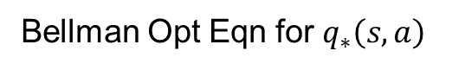
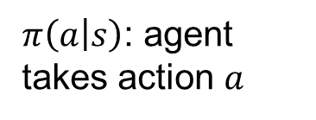
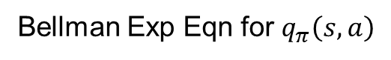
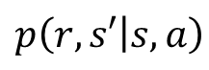
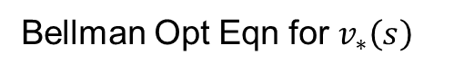
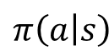
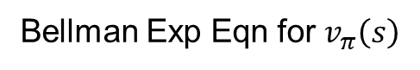
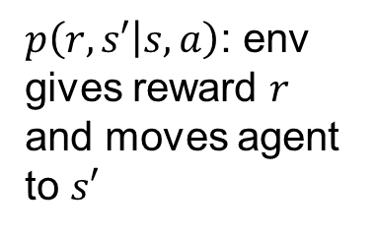
Backup Diagrams
Important
$π\left(a | s\right)$: agent takes action $a$
(state, action)
$p\left(r,s′ | s,a\right)$: env gives reward $r$ and moves agent to $s′$
max
state
Bellman Exp Eqn for $v_{π}\left(s\right)$
Bellman Opt Eqn for $v_{∗}\left(s\right)$
$$p\left(r,s′ | s,a\right)$$
$$π\left(a | s\right)$$
max
max
Bellman Exp Eqn for $q_{π}\left(s,a\right)$
Bellman Opt Eqn for $q_{∗}\left(s,a\right)$

Slide 20


$v(s)$ vs. $q(s,a)$
Important
State-action Value Function $q(s,a)$ contains more information than State value function $v(s)$. Given $q_{∗}\left(s,a\right)$, optimal policy $π_{∗}\left(s\right)=arg\max_{a} q_{∗}\left(s,a\right)$.
Can always go from $q_{π}(s,a)$ to $v_{π}(s)$, or from $q_{∗}(s,a)$ to $v_{∗}(s)$:
$v_{π}\left(s\right)=\sum_{a}{π\left(a | s\right)}q_{π}\left(s,a\right);v_{∗}\left(s\right)=\max_{a} q_{∗}\left(s,a\right)$
With known MDP ($p\left(r,s′ | s,a\right)$, i.e., model-based): can go from $v_{π}(s)$ to $q_{π}(s,a)$, or from $v_{∗}(s)$ to $q_{∗}(s,a)$:
$q_{π}\left(s,a\right)=\sum_{r,s^{′}}{p\left(r,s′ | s,a\right)}\left[r+γv_{π}\left(s′\right)\right]$
$q_{∗}\left(s,a\right)=\sum_{{r,s}^{′}}{p\left(r,s′ | s,a\right)}\left[r+γv_{∗}\left(s′\right)\right]$
With unknown MDP (unknown $p\left(r,s′ | s,a\right)$, i.e., model-free) : cannot go from $v_{π}(s)$ to $q_{π}(s,a)$, or from $v_{∗}(s)$ to $q_{∗}(s,a)$
Notes:
Can get optimal policy $π_{∗}\left(s\right)=arg\max_{a} q_{∗}\left(s,a\right)$
Cannot get optimal policy $π_{∗}\left(s\right)$ from $v_{∗}\left(s\right)$

Slide 21

Simplified Bellman Equations for Deterministic Env
Important
Bellman Equations:
$v_{π}\left(s\right)=\sum_{a}{π\left(a | s\right)q_{π}(s,a)}$
$q_{π}\left(s,a\right)=\sum_{{r, s}^{′}}{p\left(r,s′ | s,a\right)}\left[r+γv_{π}\left(s^{′}\right)\right]$
$v_{∗}\left(s\right)=\max_{a} q_{∗}\left(s,a\right)$
$q_{∗}\left(s,a\right)=\sum_{{r, s}^{′}}{p\left(r,s′ | s,a\right)}\left[r+γv_{∗}\left(s′\right)\right]$
For Deterministic Env: there is only one possible $(r,s^{′})$ for a given $(s,a)$ (we use $R_{s}^{a}$ to emphasize that reward $r$ is specific to this $(s,a)$):
$q_{π}\left(s,a\right)=R_{s}^{a}+γv_{π}\left(s^{′}\right)$
$q_{∗}\left(s,a\right)=R_{s}^{a}+γv_{∗}\left(s^{′}\right)$

Slide 22




Reinforcement Learning
Recall: an MDP consists of:
Set of states $S$
Start state $s_{0}$
Set of actions $A$
Transitions and rewards $p\left(r,s′ | s,a\right)$ (w. discount $$)
But now the model $p\left(r,s′ | s,a\right)$ is unknown
Unknown reward $r$ and next state $s′$, denoted as state transition $(s,a,r,s′)$, if agent takes action $a$ in state $s$.
Agent must learn the optimal policy $π(a|s)$ by trial-and-error.
$$p\left(r,s′ | s,a\right)$$
Notes:
Still assume an MDP:
A set of states s ∈ S
A set of actions (per state) A
A model T(s,a,s’)
We The same $(s,a)$ may lead to different reward $r$ and next state $s′$, denoted as state transition $(s,a,r,s′)$,
I.e. we don’t know which states are good or what the actions do
A reward function R(s,a,s’)

Slide 23
Characteristics of RL
There is no supervisor, only a reward signal (may be sparse)
Feedback is delayed, not instantaneous
Sequential, non i.i.d (Independent and identically distributed) data
Agent's actions affect the subsequent data it receives
Notes:
What makes RL different from other ML paradigms?

Slide 24













Model-Based vs. Model-Free
Model-Based RL: MDP planning
Learn MDP $p\left(r,s′ | s,a\right)$(given current state $s$and action $a$, returns prob distribution of current reward $r$and next state $s′$), then plan with Value Iteration or Policy Iteration
Model-Free RL: Value-based (our focus) and Policy-based
Learn value function $V\left(s\right)$ or$Q(s,a)$, or policy function $π(s)$ without learning MDP
state $s$
action $a$
state $s$
action $a$
state $s$
action $a$
MDP
$V\left(s\right)$,$Q(s,a)$
Policy $π(s)$
next
state $s′$
reward $r$
action
$$a={argmax}_{a}Q(s,a)$$
action $a=π(s)$
MDP-based RL | Value-based RL | Policy-based RL
Notes:
Model-based RL
Learn MDP model $p\left(r,s′ | s,a\right)$ then use Value Iteration or Policy Iteration to solve for the optimal value function and policy
Model-free (our focus)
Learn the optimal value function and/or policy directly without learning the MDP
Model-based
Learn MDP model $p\left(r,s′ | s,a\right)$, then solve for the optimal policy with PI or VI.
Model-free
Learn the optimal policy without learning MDP.
MPC is model-based; PID can be model-based or model-free $\left[s_{t+1},r_{t}\right]∼P(⋅|s_{t},a_{t};θ)$ $a_{t}=π(s_{t},θ)$ Estimate value $J(θ)$ and optimize it, without knowledge of model $P$Q-Learning/DQN, Policy Gradient, Imitation Learning… $θ$ denotes model params, e.g., edge weights in a DNN.

Slide 25

Model-Based RL
If MDP is not available, we can use Model-Based RL:
Step 1: Learn empirical MDP model
Estimate the model $p\left(r,s′ | s,a\right)$ by executing some policy $π$ (may be random), and keeping track of outcomes $r,s′$ for each $s, a$in the observed episodes.
Step 2: Do planning w. the learned MDP for the optimal policy
Dynamic Programming w. Value Iteration or Policy Iteration
Notes:
Learn an approximate MSP based on experiences, then solve the learned MDP
counting transitions out of each state
CH08: Planning and Learning
Normalize to estimate the probabilities $p\left(r,s′ | s,a\right)$

Slide 26












Value-based RL
state $s$
action $a$
state $s$
action $a$
state $s$
action $a$
MDP
$V\left(s\right)$,$Q(s,a)$
Policy $π(s)$
next
state $s′$
reward $r$
action
$$a={argmax}_{a}Q(s,a)$$
action $a=π(s)$
MDP Planning | Value-based RL | Policy-based RL

Slide 27


Q Learning
Off-policy, Value Iteration: in state $S$, Q update w. one-step lookahead $Q(S^{′},a)$ by taking $\max_{a}{Q(S^{′},a)}$ among all possible actions.

Slide 28



QL is Off-Policy
QL’s target policy $π$ is always greedy w.r.t $Q(s,a)$
$\sum_{a′}{π(a′|S_{t+1})}Q\left(S_{t+1},a′\right)=\max_{a′}{Q\left(S_{t+1},a′\right)}$
Behavior policy $b$ is typically more exploratory, e.g., $ε$-greedy, or uniform random, or even arbitrary policy.
No need for Importance Sampling.

Slide 29



Example 6.6: Cliff Walking
Reward is −1 on all transitions except those into the region marked “The Cliff.” Stepping into this region incurs a reward of −100 and sends the agent instantly back to the start. Env is deterministic.
Graph shows the performance of the Sarsa and Q-learning methods with $ε$-greedy action selection, $ε=0.1$. After an initial transient, Q-learning learns values for the optimal policy, that which travels right along the edge of the cliff. Unfortunately, this results in its occasionally falling off the cliff because of the $ε$- greedy action selection. Sarsa, on the other hand, takes the action selection into account and learns the longer but safer path through the upper part of he grid. Although Q-learning learns the values of the optimal policy, its online performance is worse than that of Sarsa.
If $ε$ were gradually reduced to $0$, then both methods would asymptotically converge to the optimal policy.
Notes:
Although Q-learning
learns the values of the optimal
policy, its online performance
is worse than that of Sarsa, which
learns the roundabout policy. Of course,

Slide 30

Q Learning vs. DQN
https://www.analyticsvidhya.com/blog/2019/04/introduction-deep-q-learning-python/

Slide 31



Function Approximations of Value Functions
Upper:
Left: state value function $\hat{v}(s,w)$ with params $w$.
Middle: action value function $\hat{q}(s,a,w)$ with params $w$.
Right: action value functions $\hat{q}(s,a_{i},w)$ with params $w$, since we need all Q-values for computing greedy policy ${argmax}_{a}{\hat{q}(s,a,w)}$.
Lower:
Use Neural Network as action value functions (corresponds to upper middle and right).

Slide 32


Mean Squared Error
Optimization objective is to minimize Value Error
$\overline{VE}=𝔼_{π}{\left[v_{π}\left(s\right)−\hat{v}\left(s,w\right)\right]}^{2}=\sum_{s∈𝒮}{μ\left(s\right){\left[v_{π}\left(s\right)−\hat{v}\left(s,w\right)\right]}^{2}}$
$μ\left(s\right)$ is the fraction of time spent in state $s$ when following policy $π$, called the on-policy distribution under policy $π$, $\sum_{s∈𝒮}{μ\left(s\right)}=1$. A larger $μ\left(s\right)$denotes state $s$ is visited more frequently, hence estimation error of $v_{π}\left(s\right)$ is given more weight
Notes:
i.e., probability distribution of state $s$ when following policy $π$,the on-policy
distribution under ⇡ (see

Slide 33



Gradient Descent
The $x$-axis corresponds to weight vector $w$, and the $y$-axis to the objective value (i.e., loss function) $L(w)$ for weight $w$.
To minimize $L(w)$, we adjust weight vector $w$ in the direction of the negative of the gradient $w←w−α∇L\left(w\right)$
$α$ is step-size parameter that is typically gradually reduced
$$L(w)$$
Notes:
Because we have a single weight, $,∇L\left(w\right)={\left(\frac{∂J\left(w\right)}{∂w_{1}},\frac{∂L\left(w\right)}{∂w_{2}},…,\frac{∂L\left(w\right)}{∂w_{n}}\right)}^{T}$
this means our gradient is just a scalar derivative.

Slide 34

Stochastic Gradient Descent (SGD)
Gradient Descent for minimizing Mean Squared Value Error (impractical for a large number of states)
$∇\overline{VE}=∇\sum_{s∈𝒮}{μ_{π}\left(s\right){\left[v_{π}\left(s\right)−\hat{v}\left(s,w\right)\right]}^{2}}=\sum_{s∈𝒮}{μ_{π}{∇\left[v_{π}\left(s\right)−\hat{v}\left(s,w\right)\right]}^{2}}=−2\sum_{s∈𝒮}{μ_{π}\left[v_{π}(s)−\hat{v}\left(s,w\right)\right]}∇\hat{v}\left(s,w\right)$
$w←w−\frac{1}{2}α∇\overline{VE}=w+α\sum_{s∈𝒮}{μ_{π}\left[v_{π}(s)−\hat{v}\left(s,w\right)\right]}∇\hat{v}\left(s,w\right)$
SGD: on each step, update $w$ based on a single new state $S_{t}$ and its value $v_{π}{(S}_{t})$:
$w←w+α[v_{π}\left(S_{t}\right)−\hat{v}\left(S_{t},w\right)]∇\hat{v}\left(S_{t},w\right)$
Notes:
that is gradually reduced

Slide 35


Gradient Monte Carlo
Gradient Monte Carlo: Use MC target $G_{t}$ as unbiased estimate of $v_{π}\left(S_{t}\right)$.
$w←w+α[G_{t}−\hat{v}\left(S_{t},w\right)]∇\hat{v}\left(S_{t},w\right)$
Recall $G_{t}≐\sum_{k=0}^{T−1}{γ^{k}}R_{t+k+1}$

Slide 36




Semi-Gradient TD(0) for Estimating $\hat{v}≈v_{π}$
Use TD target $R_{t+1}+γ\hat{v}\left(S_{t+1},w\right)$ as biased estimate of $v_{π}\left(S_{t}\right)$.
$w←w−\frac{1}{2}α∇{\left[R_{t+1}+γ\hat{v}\left(S_{t+1},w\right)−\hat{v}\left(S_{t},w\right)\right]}^{2}≠w+α[R_{t+1}+γ\hat{v}\left(S_{t+1},w\right)−\hat{v}\left(S_{t},w\right)]∇\hat{v}\left(S_{t},w\right)$
Since $∇\left(R_{t+1}+γ\hat{v}\left(S_{t+1},w\right)\right)≠0$
Semi-Gradient TD(0): use the semi-gradient as approximation to the real gradient
$w←w+α[R_{t+1}+γ\hat{v}\left(S_{t+1},w\right)−\hat{v}\left(S_{t},w\right)]∇\hat{v}\left(S_{t},w\right)$
It may not converge to local minimum, but it converges faster than Gradient MC due to more frequent (per timestep instead of per episode) and less noisy updates.

Slide 37

TD vs. Supervised Learning
TD tries to learn parametrize value function $\hat{v}\left(s,w\right)≈v_{π}(s)$
Learn mapping $S_{t}→R_{t+1}+γ\hat{v}(S_{t+1},w)$ from training dataset: $\left\{\left(S_{1},R_{2}+γ\hat{v}(S_{2},w)\right),\left(S_{2},R_{3}+γ\hat{v}(S_{3},w)\right),\left(S_{3},R_{4}+γ\hat{v}(S_{4},w)\right),…\right\}$
Target $R_{t+1}+γ\hat{v}(S_{t+1},w)$ depends on $w$. (non i.i.d)
c.f. Supervised Learning, with fixed and given target (i.i.d)
Learn mapping $X_{i}→\hat{y}(X_{i},w)$ from training dataset: $\left\{\left(X_{1},Y_{1}\right),\left(X_{2},Y_{2}\right),\left(X_{3},Y_{3}\right)…\right\}$
Notes:
Monte-Carlo: $\left\{\left(S_{1},G_{1}\right),\left(S_{2},G_{2}\right),\left(S_{1},G_{3}\right),…\right\}$ Policy Evaluation vs. Supervised Learning ($w$ is a set of weights)
Recall tabular TD:
$$V\left(S_{t}\right)←V\left(S_{t}\right)+α(R_{t+1}+γV\left(S_{t+1}\right)−V(S_{t}))$$

Slide 38

TD w. Linear Function Approximation
For linear value function approximation $\hat{v}\left(s,w\right)≐w^{T}x(s)$, we have $∇\hat{v}\left(s,w\right)=x(s)$
e.g. for feature vector of size 2:
$\hat{v}\left(s,w\right)≐\left[\begin{matrix}w_{1} & w_{2}\end{matrix}\right]\left[\begin{matrix}x_{1}\left(s\right) \\ x_{2}\left(s\right)\end{matrix}\right]=w_{1}x_{1}\left(s\right)+w_{2}x_{2}\left(s\right)$
$∇\hat{v}\left(s,w\right)=\left[\begin{matrix}\frac{∂\hat{v}\left(s,w\right)}{∂w_{1}} \\ \frac{∂\hat{v}\left(s,w\right)}{∂w_{2}}\end{matrix}\right]=\left[\begin{matrix}x_{1}\left(s\right) \\ x_{2}\left(s\right)\end{matrix}\right]$
Semi-gradient TD:
$w←w+α[R_{t+1}+γ\hat{v}\left(S_{t+1},w\right)−\hat{v}\left(S_{t},w\right)]x(S_{t})$
Weight update = step size $×$ TD error $×$ feature value
A theorem relating Linear TD’s fixed-point and minimum of Value Error:
$\overline{VE}\left(w_{TD}\right)≤\frac{1}{1−γ}\min_{w}{\overline{VE}(w)}$
Notes:
($γ$ is discount factor)

Slide 39

Tabular TD is a Special Case of Linear TD
For Tabular TD, feature vector is one-hot encoding of states: ${x\left(s_{i}\right)=\left[0 …0 1 0 …0\right]}^{T}$, with $1$ for the $i$-th element and $0$ for all others. This assigns a value to each individual state $\hat{v}\left(s_{i},w\right)=w_{i}$
e.g., for 2 states $s_{1},s_{2}$, we have 2 features: $x\left(s_{1}\right)=\left[\begin{matrix}1 \\ 0\end{matrix}\right],x\left(s_{2}\right)=\left[\begin{matrix}0 \\ 1\end{matrix}\right]$
$\hat{v}\left(s_{1},w\right)≐w^{T}x\left(s_{1}\right)=\left[\begin{matrix}w_{1} & w_{2}\end{matrix}\right]\left[\begin{matrix}1 \\ 0\end{matrix}\right]=w_{1}$
$\hat{v}\left(s_{2},w\right)≐w^{T}x\left(s_{2}\right)=\left[\begin{matrix}w_{1} & w_{2}\end{matrix}\right]\left[\begin{matrix}0 \\ 1\end{matrix}\right]=w_{2}$
Semi-gradient TD becomes:
$w_{i}←w_{i}+α\left[R_{t+1}+γ\hat{v}\left(S_{t+1},w\right)−\hat{v}\left(S_{t},w\right)\right]⋅1$
Same as Tabular TD: $V\left(S_{t}\right)←V\left(S_{t}\right)+α(R_{t+1}+γV\left(S_{t+1}\right)−V(S_{t}))$
Similarly, tabular MC is a special case of Linear Gradient MC.

Slide 40

Summary: Action Value Function Update Equations
Recall Sarsa:
$Q\left(S_{t},A_{t}\right)←Q\left(S_{t},A_{t}\right)+α(R_{t+1}+γQ\left(S_{t+1},A_{t+1}\right)−Q\left(S_{t},A_{t}\right))$
Semi-Gradient Sarsa w. function approximation:
$w←w+α(R_{t+1}+γ\hat{q}\left(S_{t+1},A_{t+1},w\right)−\hat{q}\left(S_{t},A_{t},w\right))∇\hat{q}\left(S_{t},A_{t},w\right)$
Recall Expected Sarsa:
$Q\left(S_{t},A_{t}\right)←Q\left(S_{t},A_{t}\right)+α(R_{t+1}+γ\sum_{a′}{π(a′|S_{t+1})Q\left(S_{t+1},a′\right)}−Q\left(S_{t},A_{t}\right))$
Semi-Gradient Expected Sarsa w. Function Approximation:
$w←w+α(R_{t+1}+γ\sum_{a^{′}}{π\left(a^{′} | S_{t+1}\right)\hat{q}\left(S_{t+1},a^{′},w\right)}−\hat{q}\left(S_{t},A_{t},w\right))∇\hat{q}\left(S_{t},A_{t},w\right)$
Recall QL:
$Q\left(S_{t},A_{t}\right)←Q\left(S_{t},A_{t}\right)+α(R_{t+1}+γ\max_{a′}{Q\left(S_{t+1},a′\right)}−Q\left(S_{t},A_{t}\right))$
Semi-Gradient QL w. Function Approximation:
$w←w+α(R_{t+1}+γ\max_{a^{′}}{\hat{q}\left(S_{t+1},a^{′},w\right)}−\hat{q}\left(S_{t},A_{t},w\right))∇\hat{q}\left(S_{t},A_{t},w\right)$
(Optional) linear function approximation $\hat{q}\left(s,a,w\right)≐w^{T}x(s,a)$
Notes:
Recall Semi-Gradient TD(0): $w←w+α[R_{t+1}+γ\hat{v}\left(S_{t+1},w\right)−\hat{v}\left(S_{t},w\right)]∇\hat{v}\left(S_{t},w\right)$

